Slide 1
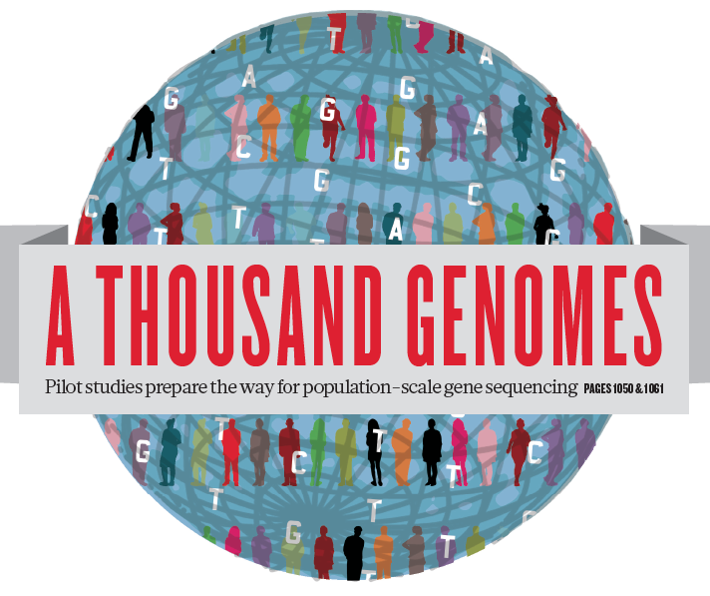
The 1000 Genomes Project Tutorial
ICHG 2011
Montreal, Quebec, Canada
October 13, 2011

Slide 2
Intro
International project to construct a foundational data set for human genetics
Discover virtually all common human variations by investigating many genomes at the base pair level
Consortium with multiple centers, platforms, funders
Aims
Discover population level human genetic variations of all types (95% of variation > 1% frequency)
Define haplotype structure in the human genome
Develop sequence analysis methods, tools, and other reagents that can be transferred to other sequencing projects

Slide 3
Agenda
Time | Topic | Presenter | Presenter affiliation
7:30 | Description of 1000 Genomes data | Gabor Marth, D.Sc. | Boston College, Boston, MA
7:55 | How to access the data | Paul Flicek, D.Sc. | EMBL European Bioinformatics Inst., Hinxton, Cambridge, UK
8:20 | Lessons in variant calling and genotyping | Hyun Min Kang, Ph.D. | Univ. of Michigan, Ann Arbor, MI
8:40 | Structural variants | Ryan Mills, Ph.D. | Brigham and Women’s Hospital, Boston, MA
9:00 | Imputation in GWAS studies | Bryan Howie, Ph.D. | Univ. of Chicago, Chicago, IL
9:20 | Q&A | - | -

Slide 4
The 1000 Genomes Project Datasets
Gabor T. Marth
Boston College Biology Department
1000 Genomes Project Tutorial
Montreal, Quebec, Canada
October 13, 2011

Slide 5
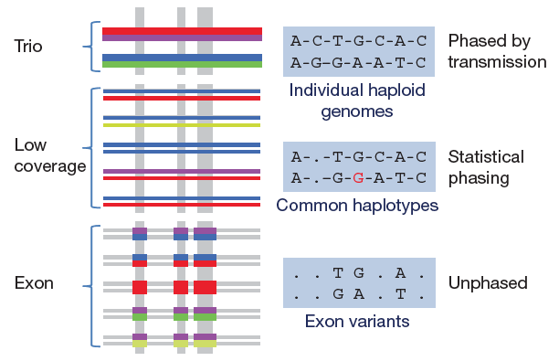
3 pilot coverage strategies

Slide 6
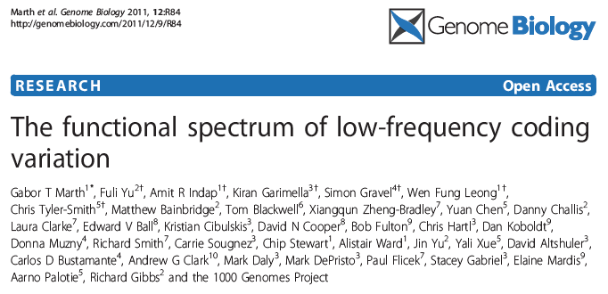
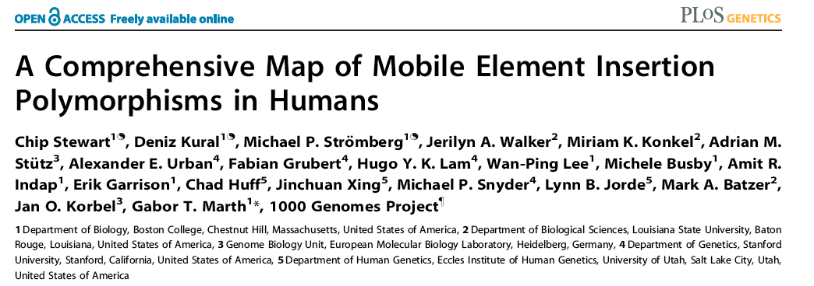
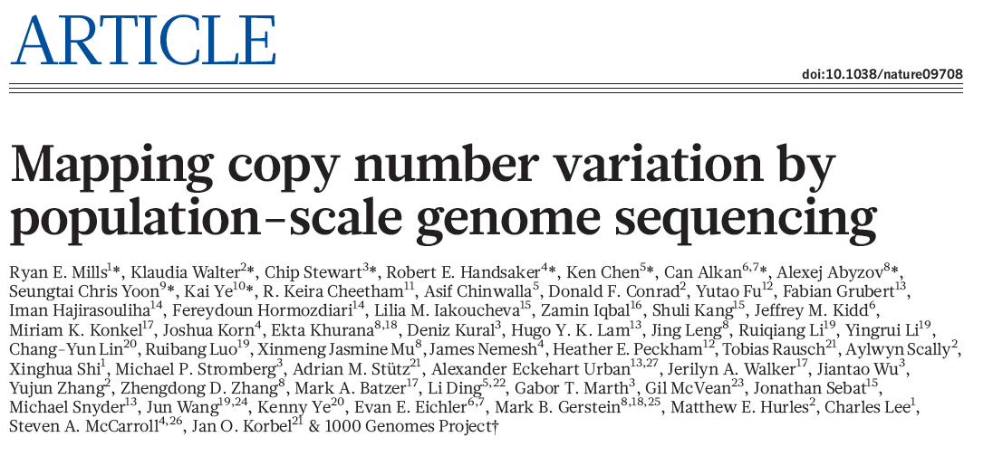
Pilot results published

Slide 7
Finalized project design
Based on the result of the pilot project, we decided to collect data on 2,500 samples from 5 continental groupings
Whole-genome low coverage data (>4x)
Full exome data at deep coverage (>50x)
A number of deep coverage genomes to be sequenced, with details to be decided
Hi-density genotyping at subsets of sites
Moved from the Pilot into Phase 1 of the project

Slide 8
Phase I (1,150)
Phase II (1,721)
Phase III (2,500)
CDX 17S
CDX (100S); DNA: 17 DNA from Bld, 83 from LCL
GIH vs. Sindhi (target – 100T)
CLM (70T); DNA from LCL
18 (5-10 trios)
Tamil (target – 100T)
KHV (82/100) – 15 trios; DNA Bld
CHS (100T); DNA from LCL
Sri Lankan (target – 100T)
45
99 (29T)
23 (7T)
51 (11 trios; 39S)
ACB (28/79T) – 14 trios; DNA Bld
Bengalee (target – 100T)
PUR (70T); DNA from Blood
13
20
26
26
9
39
27
26
22
Nigeria (target – 100T); DNA from LCL
FIN (100S); DNA from LCL
PEL (70T); DNA from Blood
Sierra Leone (target – 100T); DNA from LCL
GBR (96/100S); DNA from LCL
3
1
MAB (target – 100T); DNA from LCL
IBS (84/100T); DNA from LCL
16 (8T)
AJM (target – 80T); DNA from Bld
PJL (target – 100T); DNA from Blood
15
6
6
195
GWD
GWD
GWD
GWD (target – 100T); DNA from LCL
15
15
9
12
15
270
15
April 2009
Aug 2009
June 2009
Oct
2009
Dec
2009
Feb
2010
April 2010
June 2010
Aug 2010
Oct 2010
Dec 2010
Feb 2011
April 2011
June 2011
Aug 2011
Oct
2011
Dec 2011
Feb 2012
April 2012

Slide 9
Phase I data
Samples from 14 populations: ASW, CEU, CHB, CHS, CLM, FIN, GBR, IBS, JPT, LWK, MXL, PRU, TSI, YRI
Dataset | Low coverage whole genome | Deep coverage whole exome
# samples | 1,094 | 1,128
Sequencing technologies | Illumina, SOLiD, 454 | Illumina, SOLiD
Primary alignments (BAMs) | BWA, BFAST | MOSAIK, BFAST
Second alignments (BAMs) | MOSAIK | BWA, MOSAIK
Read coverage | 4-8X per sample | ≥70% of targets with ≥20X coverage in every sample

Slide 10
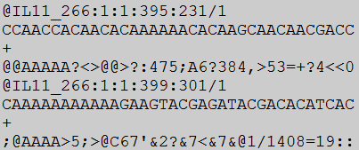
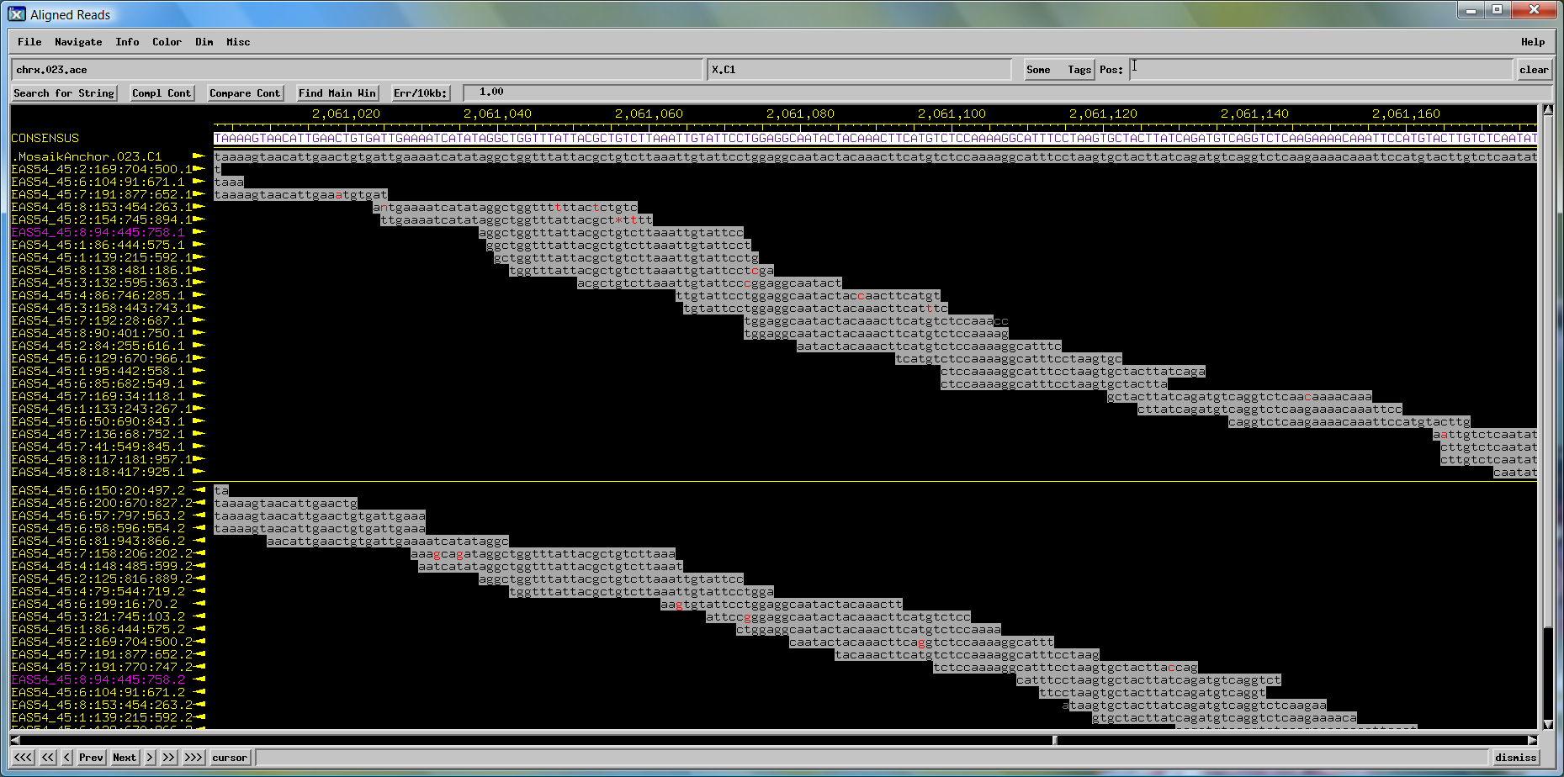
Raw data & read alignment delivery
Reads: FASTQ
Alignments: BAM
ftp://ftp.1000genomes.ebi.ac.uk

Slide 11
Phase 1 analysis goal: an integrated view of human variations
Reconstruct haplotypes including all variant types, using all datasets
Deletions
Indels
Goncalo Abecasis
SNPs (from LC, EX, OMNI)

Slide 12
Pipelines for data processing and variant calling
Tens of analysis groups have contributed
Individual pipelines and component tools vary
Typical main steps:
Read mapping
Duplicate filtering
Base quality value recalibration
INDEL realignment
Variant calling (sites)
Sample genotype calling (sometime part of variant calling)
Variant filtering / call set refinement
Variant reporting

Slide 13
SNPs

Slide 14
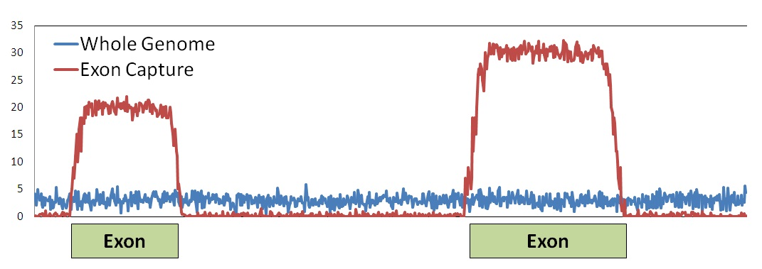
SNP calls
Dataset | Contributing datasets | Consensus method | #SNPs | # Novel SNPs | Novel Ts/Tv | %ONMI poly (sensitivity) | %OMNI mono (FDR)
Low coverage | BC, BCM, BI, NCBI, UM | VQSR | 37.9M | 29.65M | 2.16 | 98.4 | 1.80
Exome/Illumina | BC, BCM, BI, Cornell, UM | SVM | 598K | 468K | 2.74 | 98.01 | 1.97
Exome/SOLiD | BC, BCM, UM | SVM | 356K | 243K | 2.91 | 90.67 | 1.29

Slide 15
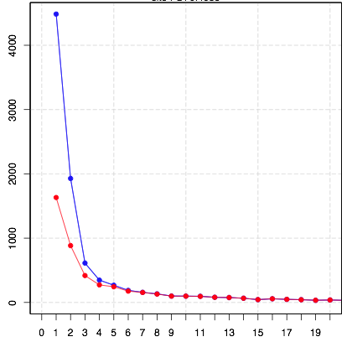
Deep coverage exome data is more sensitive to low-frequency variants
number of sites
# sites in exomes
# sites also in low coverage
Erik Garrison
Allele count in 766 exomes (chr. 20, exons only)

Slide 16
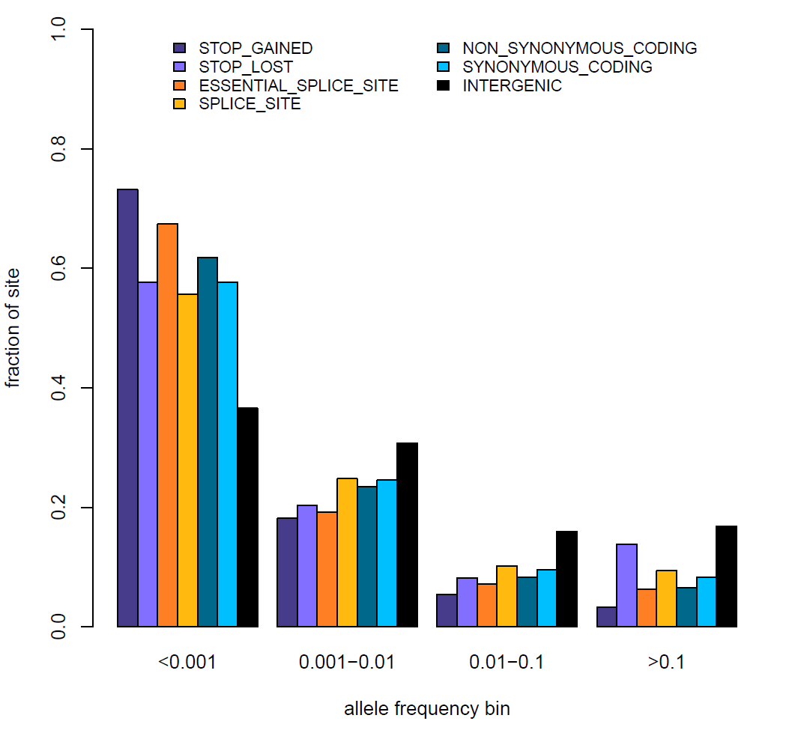
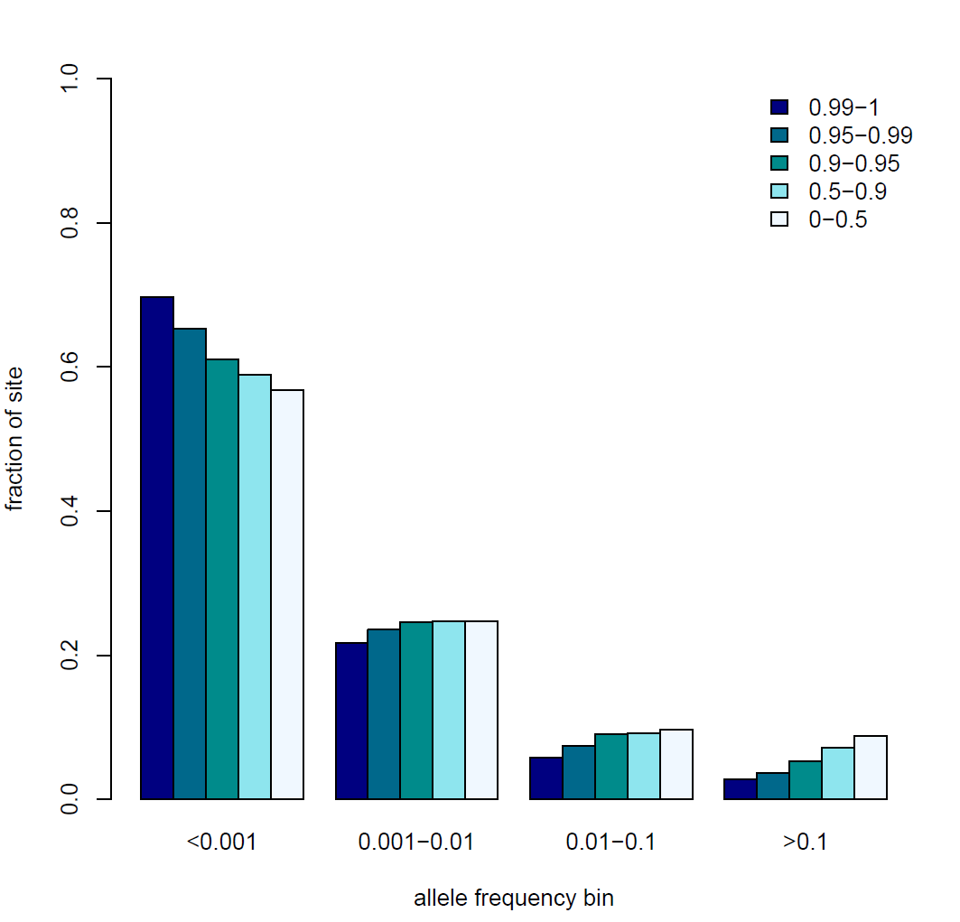
Newly discovered SNPs are mostly at low frequency and enriched for functional variants
Functional category
Non-synonymous: Condel score
Damaging
Benign
Presentation on using the data for GWAS by Brian Howie
Enza Colonna, Yuan Chen, Yali Xue

Slide 17
INDELs

Slide 18
INDEL calls
Dataset | Contributing datasets | Consensus method | #INDELs
Low coverage | BC, BI, DI, OX, SI | VQSR | 5.5M
Exome/Illumina | BC, BCM, BI | N.A. | 6.5 – 10.2K
Exome/SOLiD | BCM | N.A. | 4.2 – 5.0K
Guillermo Angel

Slide 19
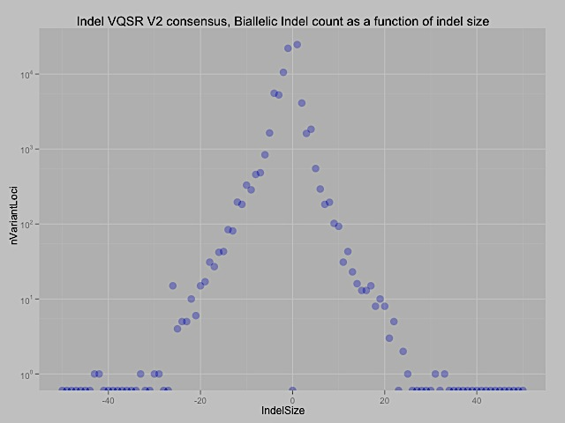
INDEL length
Guillermo Angel

Slide 20
Finding structural variants
Discovery with a number of different methods
Several types (e.g. deletions, tandem duplications, mobile element insertions) now detectable with high accuracy
We are pulling in new types for the Phase I data (inversions, de novo insertions, translocations)
Presentation on structural variations by Ryan Mills

Slide 21
SNP validations (low coverage data)
 | Total | Polymorphic | Monomorphic | No Call | Confirmation Rate | Failure Rate
All Sites | 300 | 282 | 12 | 6 | 0.959 | 0.020
Called in Validation Samples | 287 | 276 | 5 | 6 | 0.982 | 0.021
Singletons | 70 | 65 | 3 | 2 | 0.956 | 0.029
MAF<0.01* | 134 | 131 | 2 | 1 | 0.985 | 0.007
0.01<MAF<0.05 | 33 | 33 | 0 | 0 | 1.000 | 0.000
MAF>0.05 | 50 | 47 | 0 | 3 | 1.000 | 0.060
*Excludes singletons
Danny Challis, Eric Banks

Slide 22
Genotypes are accurate
Average low coverage depth is ~5x
We obtain genotypes by sharing data between samples (using imputation-related methods)
Genotypes are expected to be even more accurate after integration of multiple variant sources
Genotype | HomRef | Het | HomAlt | Overall
Error rate | 0.16% | 0.76% | 0.39% | 0.37%

Slide 23
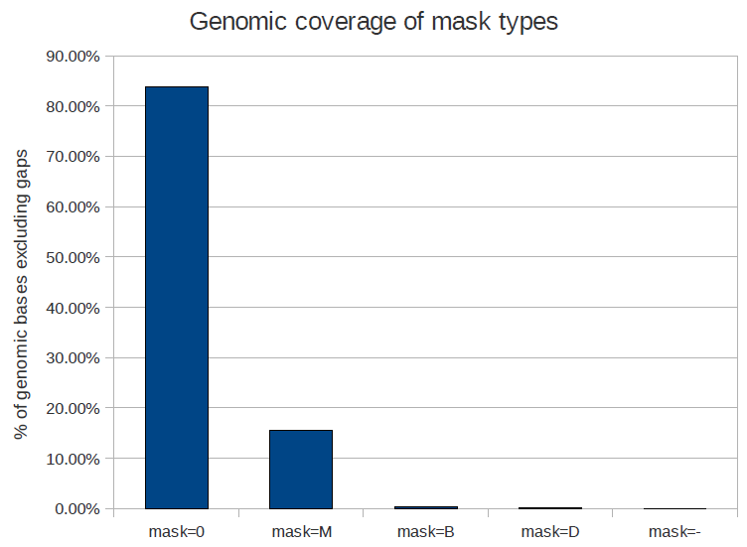
Accessible fraction of genome
In the Pilot data, we found that >80% of the human genome reference was accessible for SNP variant calling
We are currently re-evaluating this fraction for the Phase 1 data (which used longer reads)
We are developing methods to estimate the fraction for other variants (especially INDELs)
>10%
non-unique mapping
depth
too high
No coverage
M & D
Goncalo Abecasis

Slide 24
Variant call delivery
Format: VCF
ftp://ftp.1000genomes.ebi.ac.uk

Slide 25
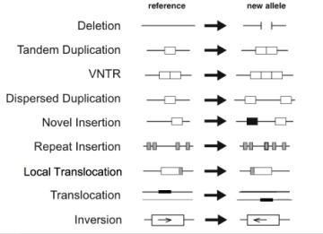
Datasets & variant types
GCGTGCTGAG
GCGTGATGAG
SNP
GCGTGCCTGAG
GCGTG--TGAG
INDEL
SV
SNP array data
Presentation on integration by Hyun Min Kang

Slide 26
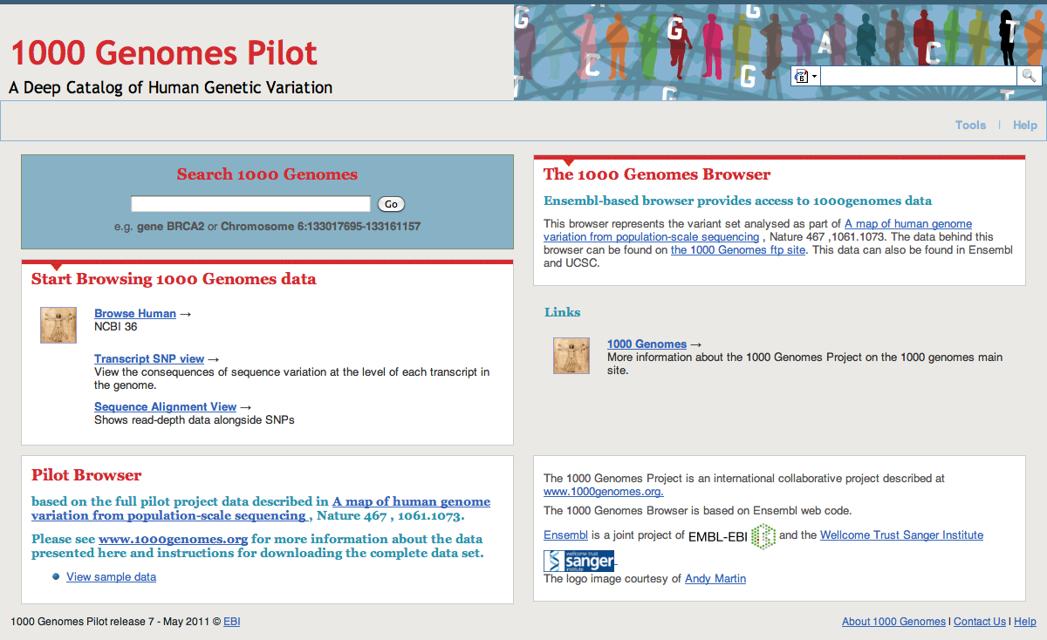
Data delivery
Presentation on data access by Paul Flicek

Slide 27
The 1000GP is a driver for method and tool development
New data formats (SAM/BAM, VCF) developed by the 1000GP are now adopted by the entire genomics community
Tools (read mappers e.g. BWA, MOSAIK, etc; variant callers including those for SVs)
Data processing protocols (BQ recalibration, duplicate read removal, etc.)
Imputation and haplotype phasing methods

Slide 28
Tools for analyzing & manipulating 1000G data
Alignments: SAM/BAM
samtools: http://samtools.sourceforge.net/
BamTools: http://sourceforge.net/projects/bamtools/
GATK: http://www.broadinstitute.org/gsa/wiki/index.php/The_Genome_Analysis_Toolkit
Variants: VCF
VCFTools: http://vcftools.sourceforge.net/
VcfCTools: https://github.com/AlistairNWard/vcfCTools

Slide 29
Project timeframe (approximate)
Phase 1
Raw data, alignments available
Integrated variant set available
Phase 1 analysis paper by end of 2011
Phase 2
Raw data mid-December 2011
Read mapping, variant calling early 2012
Phase 3
Samples end March 2012
Data Summer 2012
Call sets end of 2012, Final paper 2013?
End of the project
Richard Durbin

Slide 30
Fraction of variant sites present in an individual that are NOT already represented in dbSNP
Date | Fraction not in dbSNP
February, 2000 | 98%
February, 2001 | 80%
April, 2008 | 10%
February, 2011 | 2%
October 2011 (now) | <1%
Ryan Poplin, David Altshuler

