Slide 1
How to Access the Data
Laura Clarke
October 14th 2014

Slide 2
Size
There was 235GB of sequence in the ENA before the 1000genomes project started.
There are 461406 files on the ftp site
There are 580T of data on the ftp site
There are 26 populations
There are 2854 samples
There are 79072 gigabases of low coverage sequence
28753 x coverage in low coverage
There are 35607 gigabases of exome sequence
There are currently 1196200GB of sequence in the ENA.
Notes:
These numbers are accurate from the 9th September

Slide 3
Data Availability
FTP site: ftp://ftp.1000genomes.ebi.ac.uk/vol1/ftp/
Raw Data Files
AWS Amazon Cloud: http://aws.amazon.com/1000genomes/
FTP mirror
Web site: http://www.1000genomes.org
Release Announcements
Documentation
Ensembl Style Browser: http://browser.1000genomes.org
Browse 1000 Genomes variants in Genomic Context
Variant Effect Predictor
Data Slicer
Other Tools
Notes:
Our data is available from our ftp site and on the browser, there is documentation and release announcements on the web site.

Slide 4
FTP Site
Two mirrored ftp sites
ftp://ftp.1000genomes.ebi.ac.uk/vol1/ftp
ftp://ftp-trace.ncbi.nih.gov/1000genomes/ftp
NCBI site is direct mirror of EBI site
Can be up to 24 hours out of date
Both also accessible using aspera
http://asperasoft.com/
Available via GlobusGridFTP
EBI site has http mirror
http://ftp.1000genomes.ebi.ac.uk/vol1/ftp

Slide 5
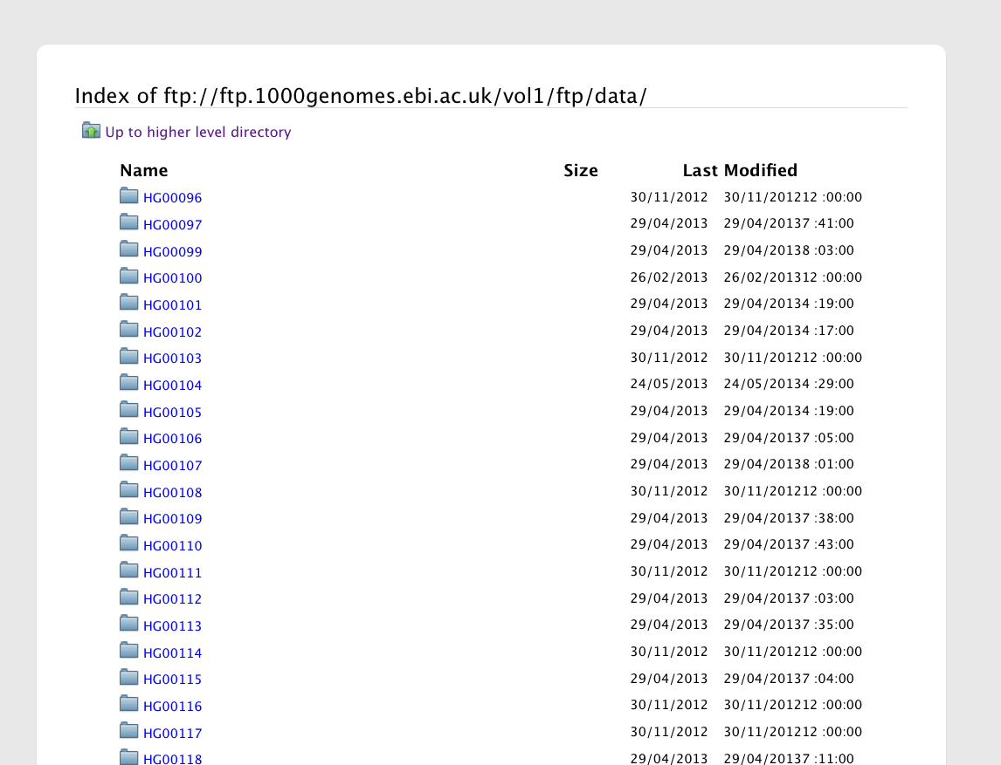
The FTP Site: Data
Sample Level Files
sequence_read
alignment
cg_data
Notes:
The data directory contains one directory per individual and each individual further has directories which contain fastq files or alignment files

Slide 6
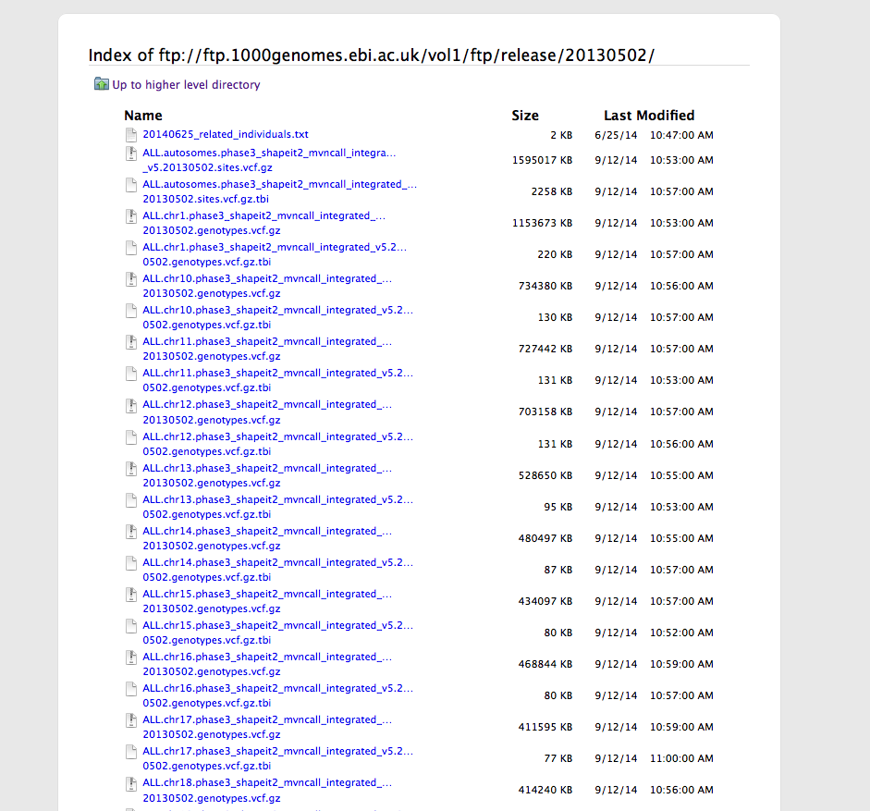
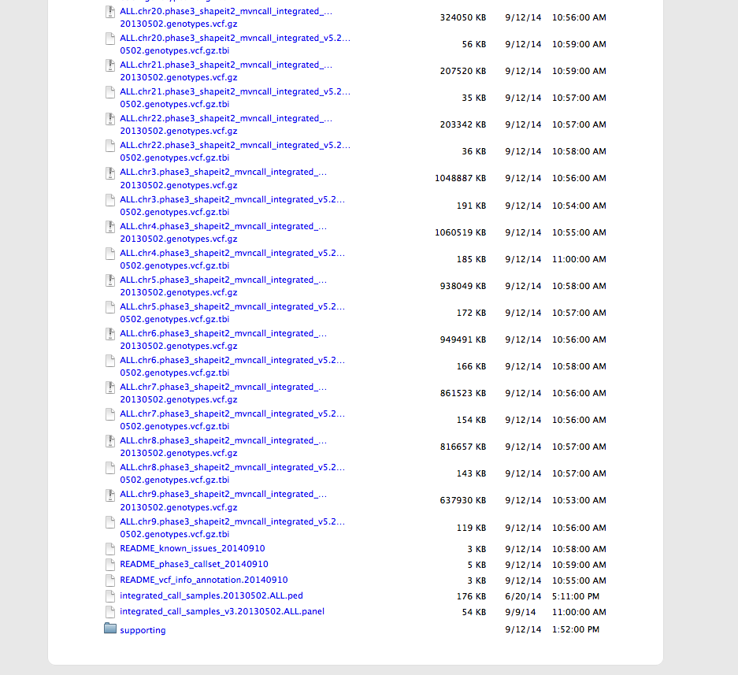
FTP Site: Phase 3
Site VCF
Genotype VCFs
Supporting Data Sets

Slide 7
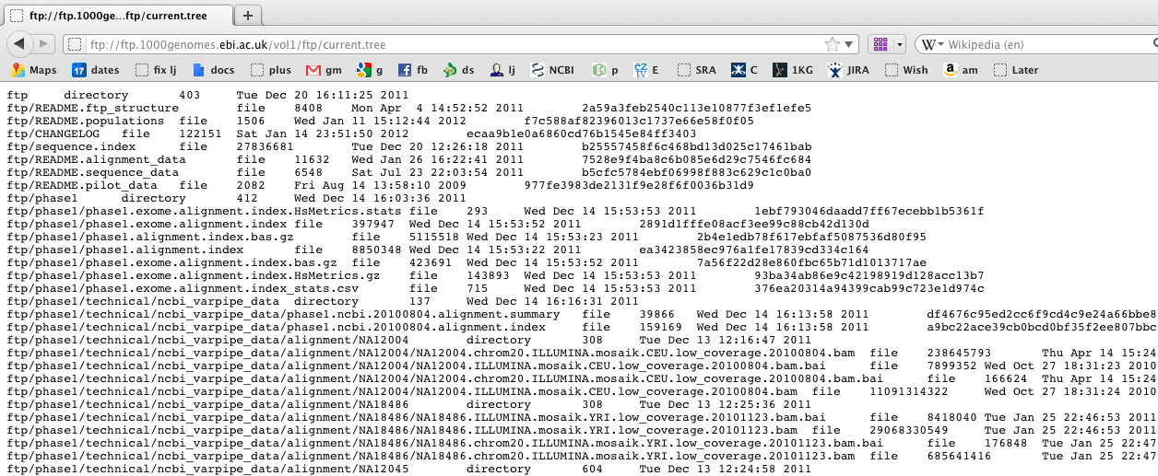
Finding Data
Current.tree file
ftp://ftp.1000genomes.ebi.ac.uk/vol1/ftp/current.tree
Current Tree is updated nightly so can be upto 24 hours out of date
Notes:
With nearly 200 terabytes of data spread over 200,000 files it can be a challenge to find what you are looking for. Mostly to aid people mirroring the site we do provide a complete record of all files on the ftp site in an index file called current.index. We try and name our files in a manner that is as useful as possible to allow people to search for files with particular contents.

Slide 8
Tools http://browser.1000genomes.org/tools.html
Data Slicer
Variation Pattern Finder
VCF to PED Converter
Variant Effect Predictor
Forge
Allele Frequency Calculator

Slide 9
Allele Frequency Calculator
1000 Genomes VCF files contain genotypes for all individuals
The individuals are from many different populations
The Allele Frequency Calculator provides per population allele frequency and alternative allele counts.

Slide 10
http://browser.1000genomes.org
Notes:
The web front end for the tools can be accessed from the tools link which is in the top right hand corner of every browser page.

Slide 11
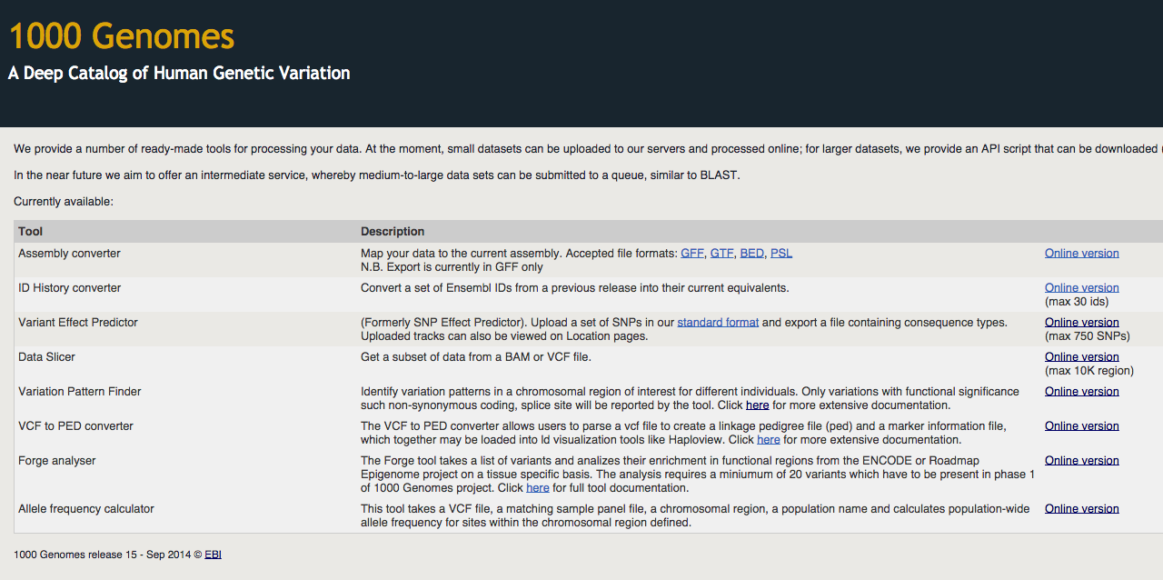
Tools page
Notes:
Here you can see the Variant Effect Predictor, Data Slicer, Variation Pattern finder and VCF to PED converter all available. All have an online version and all but the Data Slicer have an api script. To do what the data slicer does on the command line you need to use tabix and samtools as you were shown earlier.

Slide 12
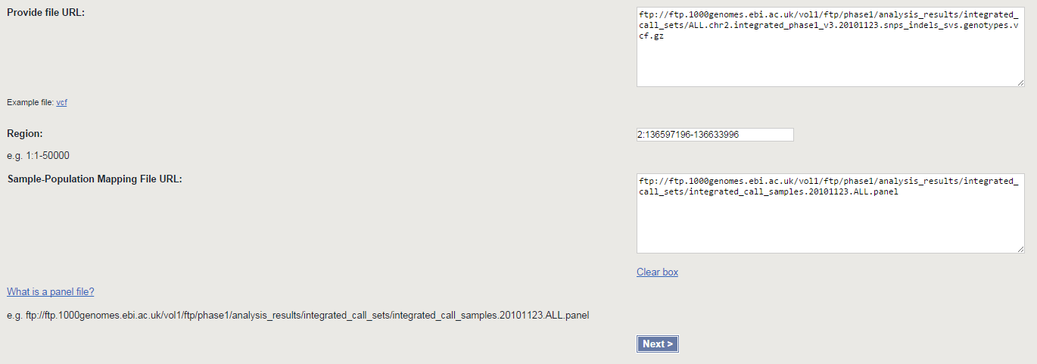
Allele Frequency Calculator

Slide 13
Allele Frequency Calculator

Slide 14
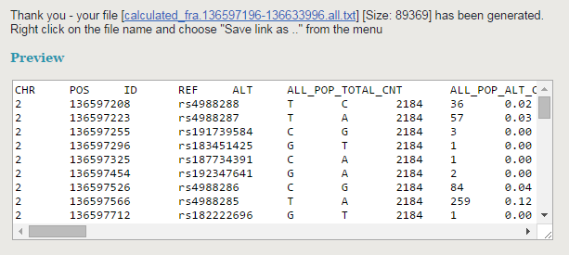
Allele Frequency Calculator

Slide 15
Allele Frequency Calculator
CHR POS ID REF ALT AN AC FREQ
2 136606360 rs4988252 A C 198 198 1
2 136606413 rs4988251 A C 198 198 1
2 136606741 rs2082730 G T 198 198 1
2 136607870 rs6752360 A T 198 198 1
2 136607871 rs6752362 A C 198 198 1
2 136607976 rs10648294 T TCTCTC 198 198 1
2 136608466 rs4954492 C A 198 198 1
2 136608231 rs4954490 G A 198 158 0.8

Slide 16
The Future
The International Genome Sample Resource (IGSR), a Wellcome Trust funded project that will be built on the foundation of the 1000 Genomes Project starts in 2015.
IGSR plans to:
Maintain the existing 1000 genomes data and move to GRCh38
Collect other data sets generated on the Coriell Cell Lines including Geuvadis
Add new populations to expand the global diversity of the variant catalog

Slide 17
Announcements and Contact Info
http://1000genomes.org
1000announce@1000genomes.org
http://www.1000genomes.org/1000-genomes-annoucement-mailing-list
http://www.1000genomes.org/announcements/rss.xml
http://twitter.com/#!/1000genomes
Please send questions to info@1000genomes.org

Slide 18
Acknowledgements
The 1000 Genomes Consortium Ensembl Variation
Paul Flicek Fiona Cunningham
Holly Zheng Bradley Will McLaren
Bert Overduin Laurent Gil
Emily Pritchard Anja Thormann
Ian Streeter Sarah Hunt
Avik Datta The Rest of Ensembl
David Richardson
Forge
Ian Dunham

